Slide 1
ERTS Final Assessment – Task 2 (Template)
Kalyan Sudra – eo20203
Ronaldo Balram – nz20469
Khush Shah – bi20475
Qijia Tang – dm22509

Slide 2
Practical elements
Show that the LED has been used effectively
Show that the robot can move around effectively
Show that the robot can play a tune
Show that all of this works simultaneously

Slide 3
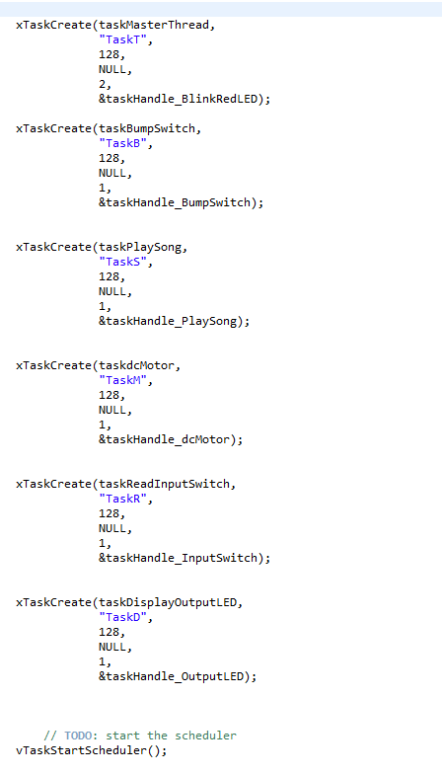
Tasks/Scheduling
We created various tasks with “taskMasterThread” having the highest priority and utilised the round robin scheduling algorithm.
With round robin at a high frequency, all tasks seem to be running concurrently on a single processor.
Tasks are easily able to be suspended and resumed re-joining the schedule.
All of the tasks can be executed before their deadlines, and non of the task is in congestion.

Slide 4
Resource control
How have you controlled access to any shared data/hardware?
We have controlled access to shared data using the various tasks and the paths you take.
“bumpSwitch_status” is a global variable used to store the status of bump switchs, and the value is shared in different functions.
The “status” in “taskdcMotor” function is work as a flag. The non-bump move in dcMotor.c is cut into small progresses, and “status” keeps the schedule of the move after each execute in task function.
There are taskhandles which is declared in tasks creation. When do operation to the tasks, the corresponding corresponding is called.
for example: taskHandle_PlaySong, used in “vTaskSuspend(taskHandle_PlaySong)”

Slide 5
Suspend and Delete
What is the difference between suspend and delete task and what are their uses ?
Tasks that are deleted are removed from “all ready, blocked, suspended and event lists”. No longer able to be used. Useful to delete a task and free memory.
Suspended tasks are unable to execute unless explicitly told to meaning it can stop and resume to join the round robin schedule again

